Slide 1

A GLP-1 Receptor Agonist CV Outcomes Trial
Final Results

Slide 2

Background

Slide 3
Trends in the Prevalence of Complications among
US Adults with Newly Diagnosed Diabetes
0.003
<0.001
0.64
0.86
0.30
0.90
0.35
0.95
Fang M & Selvin E Diabetes Care 2021;44:699-706

Slide 4
CKD and Rate of CV Events in 1,120,295 Adults* in a Large Health Care System
10% with diabetes. As with diabetic subjects, CV event rate increased progressively with declining in non-diabetic subjects
Go AS et al New Engl J Med 2004;351:1296-1305

Slide 5
GLP-1 RA CVOT Meta-analysis: CVD & Death
Kristensen et al. Lancet D&E 2019; 776-785
Cardiovascular Event | GLP-1 RA (n = 27,977) | Placebo (n = 28,027) | HR (95% CI) | NNT (95% CI) | P
MI, Stroke, CV Death | 2,948 | 3,304 | 0.88 (0.82–0.94) | 75 (50–151) | <0.001
Cardiovascular Death | 1,213 | 1,371 | 0.88 (0.81–0.96) | 175 (110–524) | 0.003
Fatal or Nonfatal MI | 1,540 | 1,666 | 0.91 (0.84–1.00) | 193 (108–N/A) | 0.043
Fatal or Nonfatal stroke | 722 | 853 | 0.84 (0.76–0.93) | 209 (139–477) | <0.001
All-cause Death | 1,916 | 2,156 | 0.88 (0.08–0.95) | 113 (80–271) | 0.001
Heart Failure | 931 | 1,021 | 0.91 (0.83–0.99) | 311 (164–2797) | 0.028
Effect of exendin-4 based GLP-1 RAs is uncertain
CV = cardiovascular; HR = hazard ratio; MACE = major cardiovascular events; MI = myocardial infarction; NNT = number needed to treat.

Slide 6
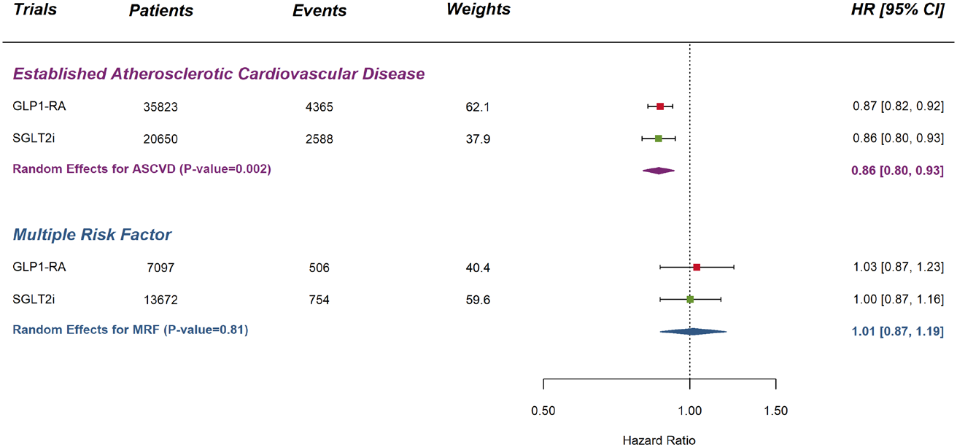
Meta-Analysis of GLP1-RA and SGLT2i Trials on the
Composite of Myocardial Infarction, Stroke, and CV Death
Zelniker TA et al Circulation 2019;139:2022-2031

Slide 7
Proportion of CVOT populations with kidney disease at baseline (eGFR <60 ml/min/1.73 m²)
(Lixisenatide) N=6068 | (Liraglutide) N=9340 | (Semaglutide) N=3297 | (Canagliflozin) N=4330 | (Canagliflozin) N=5811 | (Exenatide QW) N=14752 | (Semaglutide) N=3183
Pfeffer MA et al. N Engl J Med 2015;373:2247; Marso SP et al. N Engl J Med 2016;375:311; Marso SP et al. N Engl J Med 2016;375:1834; 9. Neal B, et al. Am Heart J 2013;166;217–223;
Neal B, et al. Diabetes Obes Metab 2017;19:387–393; Holman RR et al N Engl J Med 2017;377:1228; Husain M et al N Engl J Med. 2019;381:841-851

Slide 8
GLP-1 RA CVOT Meta-analysis: Renal Events
Kristensen et al. Lancet D&E 2019; 776-785
Renal Event | GLP-1 RA | Placebo | HR (95% CI) | NNT | P
Composite (with Albuminuria) | 1716/20,160 9% | 2017/20,142 10% | 0.83 (0.78, 0.89) | 62 | <0.0001
Worsened Renal Function | 555/20,753 3% | 662/20,762 3% | 0.87 (0.73, 1.03) | 245 | 0.098

Slide 9
Efpeglenatide
Efpeglenatide is an exendin-4 based GLP-1 RA
Conjugated with IgG4 Fc fragment to prolong half-life
Doses range from 4 to 6 mg/week given sc
Similar clinical effects to other GLP-1 RAs in Phase 2 & 3 trials
Lowers glucose without hypoglycemia & promotes weight loss
Effect on CV & kidney outcomes is unknown & was therefore tested in a CV outcomes trial

Slide 10
The AMPLITUDE O Trial
The AMPLITUDE O trial assessed the CV & kidney effects of efpeglenatide in people with type 2 DM &:
A high prevalence of cardiovascular disease
A high prevalence of renal disease
A high HbA1c
Moderate use of an SGLT2i

Slide 11
Design and Baseline Characteristics

Slide 12
AMPLITUDE O Leadership & Operations
International Steering Committee
HC Gerstein (Chair), K Branch, S Del Prato, NS Khurmi, CSP Lam, R Pratley, J Rosenstock, N Sattar
Independent Data Monitoring Committee
J Buse (Chair), R Henry (former chair), D Comblath, D Larrey, KK Ray, M Roden, WJ Shih
Clinical Events Committee (Duke)
RD Lopes (Chair), O Wolf, KW Mahaffey, GP Steg, B Kolls, C Melloni, D Kong, D Fisher, D Jordan, K Alexander, L Sposato, R Mehta, R Harrison, R Mathews, R McGarrah III, S Jones, S Shah, T Povsic, Z Gellad, D Leiman, L Jackson, S Al-Khatib, O Jawitz, Lowenstern, G Marquis-Gravel, J Rymer, M Fudim, M Nanna, S Greene, T Inohara, Z Loring, D Chew, R Loungani, Z Wegermann, M Zeitouni, L Perkins, P Endlsey, J Collier, J Morgan, G Beaulieu, A Lowe, T Chau, L Brown, M Johnson, K Stringfellow, S Clifton
Sanofi Project Office (Sponsor)
NS Khurmi, E Niemoeller, P Iacono, I Ajari, G Liu, M Stefanova-Urena, D Goldman, S Hu, R Wen, M Astrie
Population Health Research Institute (Independent Statistical Analysis)
L Dyal, L Heenan, C Ramasundarahettige, O Shestakovska, P Rao-Melacini

Slide 13
Study Questions
Primary: Is a weekly injection of 4 or 6 mg of efpeglenatide noninferior to placebo with regards to MACE outcomes in people with type 2 diabetes at high risk for CV events?
Secondary: In these people, is a weekly injection of 4 or 6 mg of efpeglenatide superior to placebo with regards to:
a) MACE? (i.e., non-fatal MI, a non-fatal stroke, or death from CV or undetermined causes)
b) MACE/ coronary revascularization/ unstable angina hospitalization?
c) New or worsening nephropathy?
    (i.e., new albumin-creatinine ratio [ACR] >300 mg/g plus a rise ≥ 30% from baseline; or ≥ 40% fall in eGFR from baseline for ≥30 days; or dialysis for ≥90 days; or renal transplant; or eGFR <15 mL/min/1.73 m² for ≥30 days)

Slide 14
Participants
Key Inclusion Criteria
Men & women with type 2 DM, HbA1c > 7% plus high CV risk defined as either: Age ≥ 18 with prior CVD (CAD, Stroke, PAD, or UA hospitalization in prior 12 months) Age ≥ 50 (M)/55 (F), eGFR 25 -59.9 & either obesity (body mass index ≥ 35 kg/m²) high LDL or low HDL on statin in prior 6 months current smoking albuminuria (UACR ≥ 30 mg/g) SBP >140 or DBP >90 mmHg despite BP drugs CAD in 1st degree relative (M <55 y, F < 65 y)
CVD = cardiovascular disease; CAD = coronary artery disease; PAD = peripheral arterial disease; ; F= female; M = male; eGFR = estimated glomerular filtration rate;
UA = unstable angina; UACR – urine albumin/creatinine; DPP-4i = dipeptidyl peptidase-4 inhibitor;

Slide 15
Participants
Key Inclusion Criteria | Key Exclusion Criteria
Men & women with type 2 DM, HbA1c > 7% plus high CV risk defined as either: Age ≥ 18 with prior CVD (CAD, Stroke, PAD, or UA hospitalization in prior 12 months) Age ≥ 50 (M)/55 (F), eGFR 25 -59.9 & either obesity (body mass index ≥ 35 kg/m²) high LDL or low HDL on statin in prior 6 months current smoking albuminuria (UACR ≥ 30 mg/g) SBP >140 or DBP >90 mmHg despite BP drugs CAD in 1st degree relative (M <55 y, F < 65 y) | Upper GI disease Pancreatitis Medullary Thyroid Cancer Active diabetic retinopathy GLP-1 RA/DPP4i use (3 months) eGFR < 25 ml/min/1.73m² High liver function test, amylase, lipase, or calcitonin Short life expectancy
CVD = cardiovascular disease; CAD = coronary artery disease; PAD = peripheral arterial disease; ; F= female; M = male; eGFR = estimated glomerular filtration rate;
UA = unstable angina; UACR – urine albumin/creatinine; DPP-4i = dipeptidyl peptidase-4 inhibitor;

Slide 16
Design Features
International RCT randomizing eligible patients 1:1:1 to 4 mg efpeglenatide or 6 mg efpeglenatide or placebo
Stratified randomization: current or future use of SGLT2i or neither
Visits @ baseline & week 12, 24 then every 24 weeks
Study medication was added to pre-randomization therapy
No change in glucose-lowering meds until 12 week visit unless baseline HbA1c < 7.5% & on insulin/sulfonylurea/meglitinide
No use of any GLP1 RA or DPP4 inhibitor

Slide 17
Design Features
Assuming placebo MACE rate >3.7% & 12-month recruitment, N~4000 provided 90% power for non-inferiority at 1.3 margin
Study Duration: until 330 MACE events
If non-inferiority for the primary outcome, additional outcomes were hierarchically assessed for superiority until non-significant:
  MACE
  MACE or coronary revascularization or unstable angina hospitalization
  New or worsening nephropathy (i.e., renal composite)
  MACE or non-CV death
  Renal function outcome (i.e., outcome 3 [without albuminuria criterion] or death)
  MACE, non-CV death, heart failure, or renal function outcome
Notes:
.

Slide 18
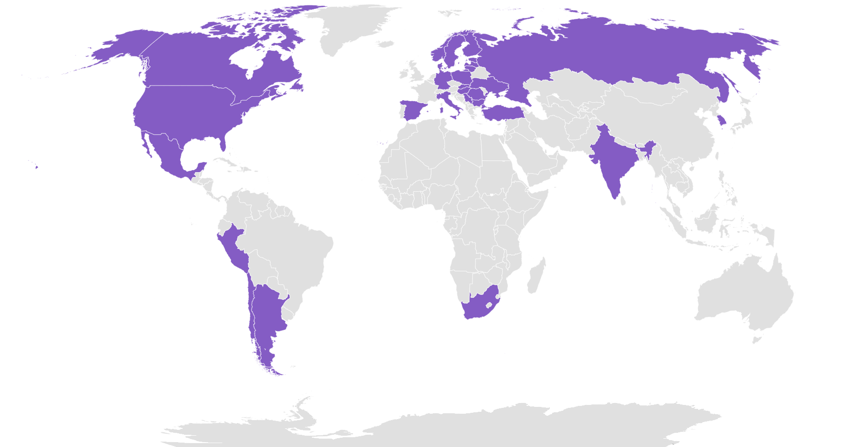
Recruitment at 344 sites from May 2018 – April 25, 2019
4076 people
in 28 countries
on 5 continents
Participants were randomly assigned to:
  efpeglenatide 4 mg sc/week
  efpeglenatide 6 mg sc/week
  weekly sc placebo
analyzed together

Slide 19
Baseline Characteristics: N = 4076
Age (years) | 64.5 (8.2)*
Females | 33%
White | 87%
Tobacco Use | 16%
Diabetes Duration (years) | 15.4 (8.8)
Prior CV Disease | 90%
eGFR < 60 ml/min/1.73m² | 32%
Prior CVD & eGFR < 60 | 22%
Prior Heart Failure | 18%
Hypertension | 91%
Prior Retinopathy | 33%
Albuminuria | 49%
BMI (kg/m²) | 32.7 (6.2)
BP (mm Hg) | 135/77
*Standard Deviations are shown within brackets

Slide 20
Baseline Drug Use: N = 4076
Glucose Lowering Drugs
None | 2%
Any Insulin | 63%
Metformin | 73%
Sulfonylureas | 25%
SGLT2 inhibitor | 15%
Cardiovascular Drugs
ACE-I/ARB/ARNI | 80%
Beta Blockers | 66%
Statins | 81%
Fibrates | 9%
ASA | 68%
Other Antiplatelet Drugs | 26%
ACE-I = angiotensin converting enzyme inhibitor; ARB = angiotensin receptor blocker; ARNI = Angiotensin receptor-neprilysin inhibitor

Slide 21
Baseline Lab Tests: N = 4076
 | Conventional Units | SI Units
HbA1c | 8.9 (1.5)% | 74 (16)* mmol/mol
Total Cholesterol | 162 (47) mg/dl | 4.21 (1.23) mM
LDL Cholesterol | 81 (39) mg/dl | 2.07 (0.98) mM
HDL Cholesterol | 42 (12) mg/dl | 1.11 (0.31) mM
Triglyceride | 174 (125, 250) mg/dl | 1.91 (1.37, 2.75) mM
eGFR | 72 (22) ml/min/1.73m² | 72 (22) ml/min/1.73m²
Urine ACR | 28.2 (9.7, 114.2) mg/g | 3.2 (1.1, 12.9) mg/mmol
*Standard Deviations are shown within brackets

Slide 22
Follow-up
Median Follow-up (IQR): 1.81 years (1.89, 1.98)
Person-years of Follow-up = 7395.4

Slide 23
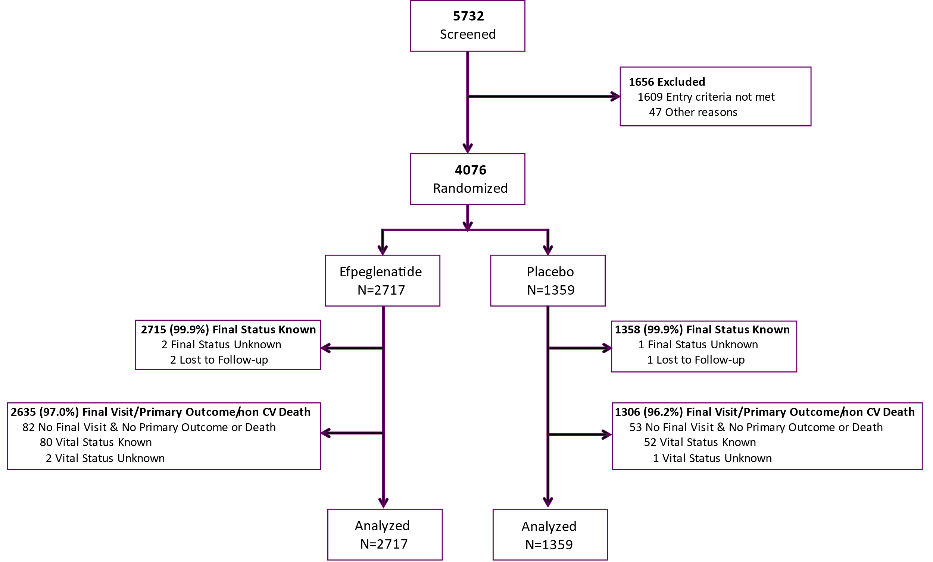
Patient Disposition
96.7% Retention
i.e., primary outcome, final visit without primary outcome, or non-CV death
99.9% Vital Status

Slide 24
Adherence to Study Drug
In 4076 Participants Followed for a Median of 1.8 years
 | Efpeglenatide (4 or 6 mg) N = 2717 | Placebo N = 1359
% of Follow-up Time on the Study Drug | 88.9% | 91.1%
On Study Drug at Last Visit | 80.7% | 80.4%
Stopped due to an adverse event | 5.4% | 3.6%

Slide 25
Effect on HbA1c, Weight, BP, HR, eGFR & Adverse Events

Slide 26
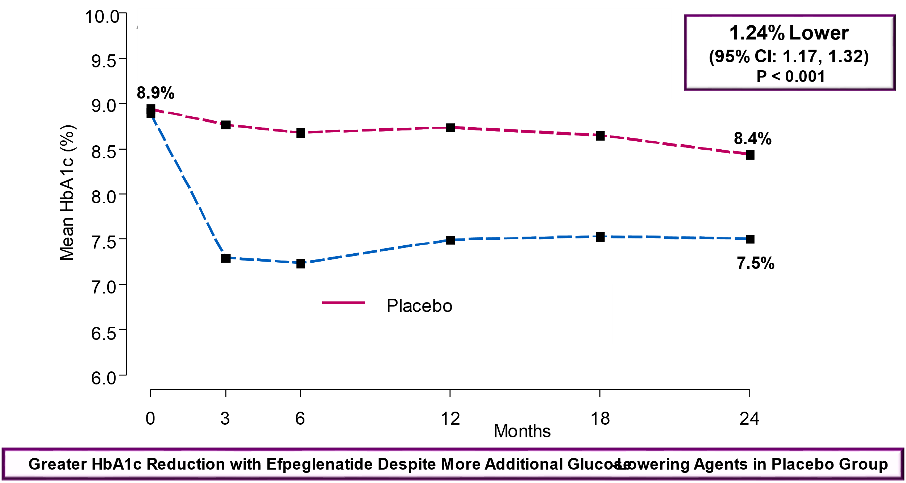
Effect of Efpeglenatide on Clinical Measures
HbA1c Changes Over Time

Slide 27
Medication Changes at Final Visit
Increased Use of Glucose-Lowering Agents in Placebo Group
 | Efpeglenatide | Placebo
Had a Final Visit | 2715 | 1358
Metformin (%) | 1975 (72.7) | 991 (73.0)
Sulfonylureas (%) | 652 (24.0) | 354 (26.1)
Insulin (%) | 1723 (63.5) | 884 (65.1)
DPP4 inhibitor (%) | 24 (0.9) | 26 (1.9)
SGLT2 inhibitor (%) | 475 (17.5) | 288 (21.2)
ACE inhibitor or ARB (%) | 2161 (79.6) | 1085 (79.9)
Statin (%) | 2222 (81.8) | 1098 (80.9)
Aspirin (%) | 1859 (68.5) | 921 (67.8)
Beta blocker (%) | 1842 (67.9) | 896 (66.0)

Slide 28
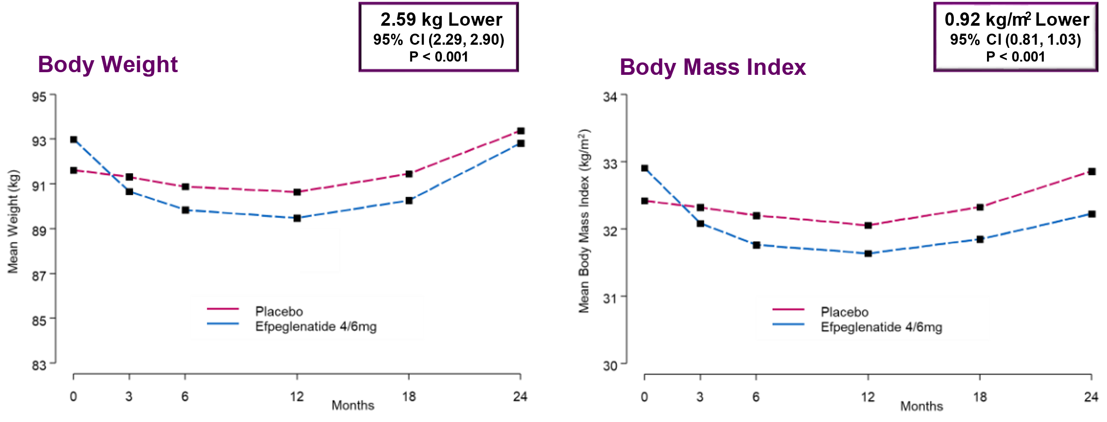
Effect of Efpeglenatide on Clinical Measures
Body Weight and BMI Changes Over Time

Slide 29
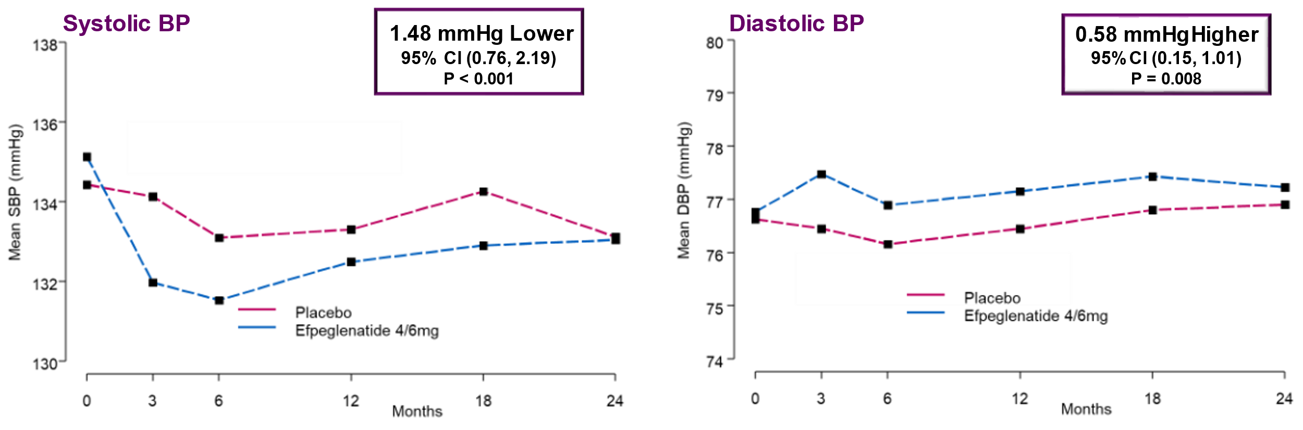
Effect of Efpeglenatide on Clinical Measures
Blood Pressure Changes Over Time

Slide 30
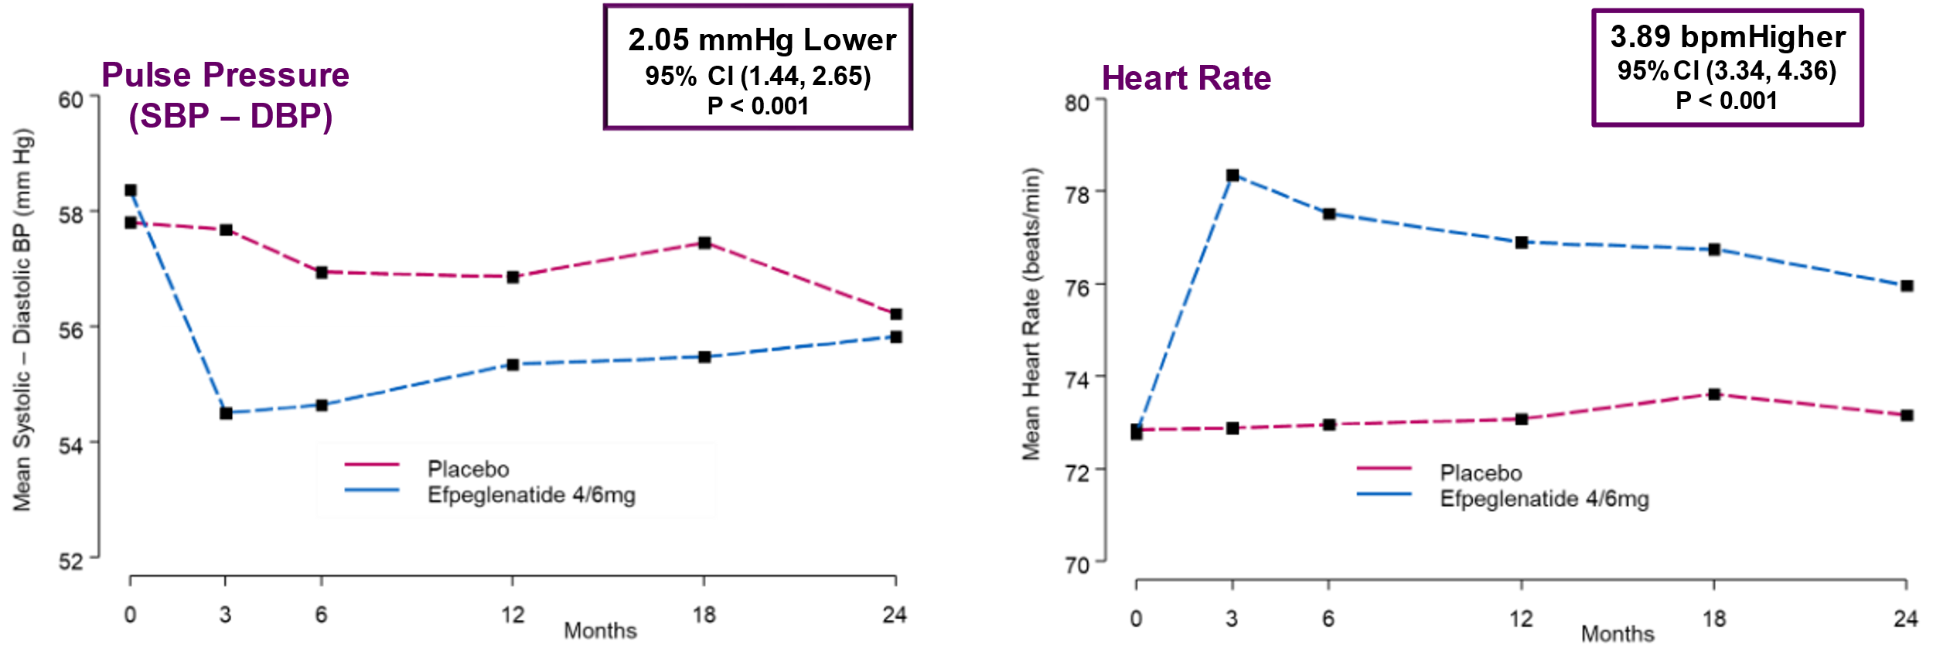
Effect of Efpeglenatide on Clinical Measures
Pulse Pressure and Heart Rate Changes Over Time

Slide 31
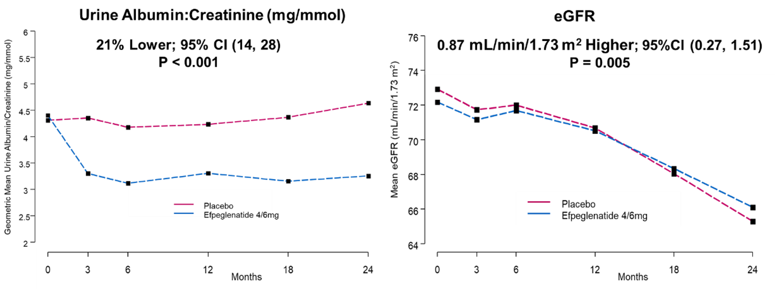
Effect of Efpeglenatide on UACR & eGFR Levels

Slide 32
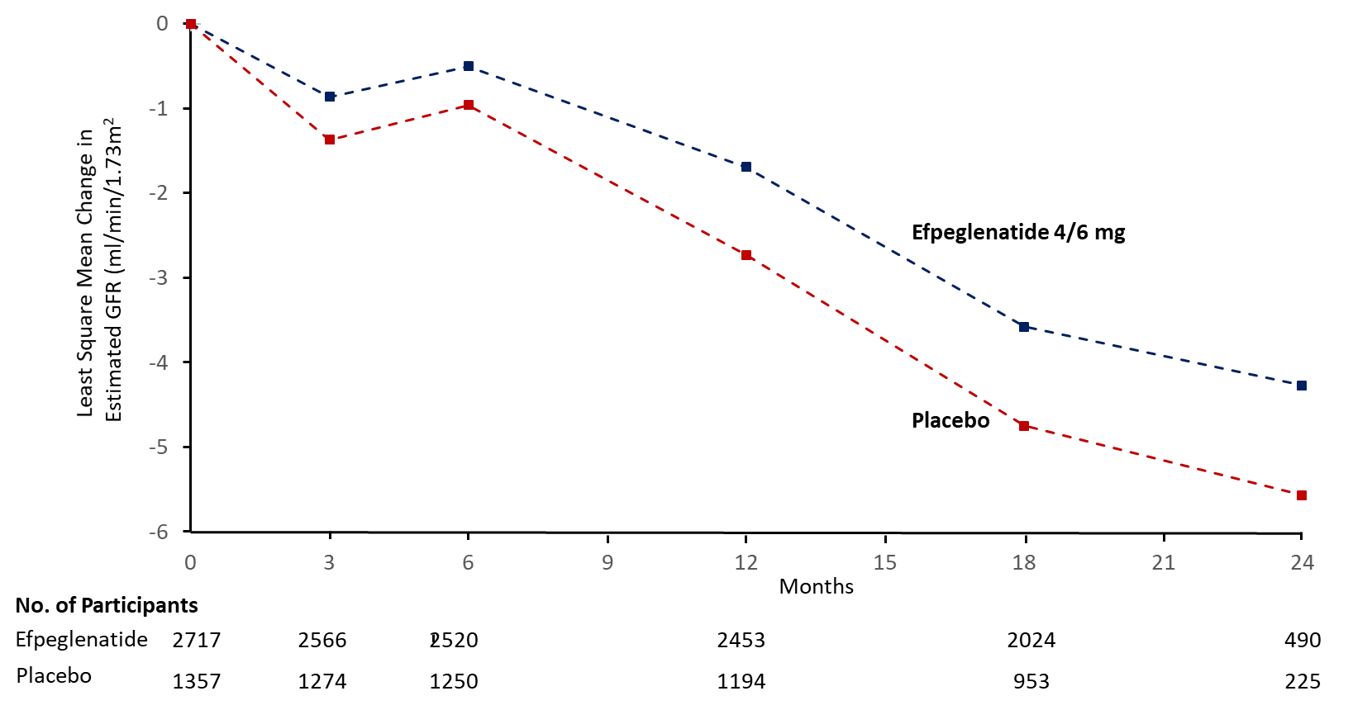
Effect of Efpeglenatide on Change in eGFR

Slide 33
Effect of Efpeglenatide on Adverse Events
Prespecified AEs
 | Efpeglenatide (N = 2717) | Placebo (N = 1359) | P
Discontinuations for AE | 147 (5.4%) | 49 (3.4%) | 0.015
Severe GI | 90 (3.3%) | 25 (1.8%) | 0.0090
Constipation, Diarrhea, Nausea, Vomiting, Bloating | 32 (1.2%) | 6 (0.4%) | 0.028
Other Severe GI | 59 (2.2%) | 19 (1.4%) | 0.10
Pancreatic Event | 32 (1.2%) | 15 (1.1%) | 0.87
Pancreatic Cancer | 2 (<0.1%) | 3 (0.2%) | N/A
Pancreatitis | 11 (0.4%) | 7 (0.5%) | 0.59

Slide 34
Effect of Efpeglenatide on Adverse Events
Prespecified AEs
 | Efpeglenatide | Placebo | P
Any Cancer | 72 (2.6%) | 37 (2.7%) | 0.81
Thyroid C-Cell Neoplasm | 0 | 0 | N/A
Calcitonin Rise > 5.9 mmol/L | 41 (1.5%) | 20 (1.5%) | 0.99
Severe Hypoglycemia | 24 (0.9%) | 13 (1.0%) | 0.67
Diabetic Retinopathy & Related Problems | 47 (1.7%) | 27 (2.0%) | 0.50
Acute Renal Failure | 88 (3.2%) | 39 (2.9%) | 0.62
Severe Injection Site Reaction | 0 | 1 (<0.1) | N/A
Severe Allergic Reaction | 5 (0.2%) | 1 (0.1%) | N/A
Severe Immune Complex Disease | 13 (0.5%) | 1 (<0.1%) | 0.096

Slide 35
Effect of Efpeglenatide on Adverse Events
Other Severe and Non-Severe AEs
No Increase in Any Other Spontaneously Reported Adverse Events for Efpeglenatide vs. Placebo

Slide 36
Effect of Efpeglenatide on Clinical Measures
Summary
 | Efpeglenatide LSM (SE) | Placebo LSM (SE) | Adjusted LSM Difference 95% CI
HbA1c (%) | -1.42 (0.02) | -0.17 (0.03) | -1.24 (-1.32, -1.17)
Systolic BP (mm Hg) | -2.56 (0.23) | -1.08 (0.32) | -1.48 (-2.19, -0.76)
Diastolic BP (mm Hg) | 0.47 (0.14) | -0.11 (0.19) | 0.58 (0.15, 1.01)
Pulse Pressure (mm Hg) | -3.01 (0.20) | -0.96 (0.27) | -2.05 (-2.65, -1.44)
Heart Rate (bpm) | 4.62 (0.15) | 0.72 (0.21) | 3.89 (3.43, 4.36)
BMI (kg/m²) | -1.15 (0.03) | -0.23 (0.05) | -0.92 (-1.03, -0.81)
Weight (kg) | -3.21 (0.10) | -0.62 (0.13) | -2.59 (-2.90, -2.29)
LDL (mmol/L) | -0.05 (0.02) | 0.02 (0.02) | -0.07, (-0.12, -0.03)
eGFR (ml/min/1.73m²) | -2.37 (0.20) | -3.26 (0.27) | 0.89 (0.27, 1.51)
Ln (Urine ACR) | 0.63 (1.03) | 0.81 (1.04) | 0.79 (0.72, 0.86)

Slide 37
Primary & Secondary Outcomes

Slide 38
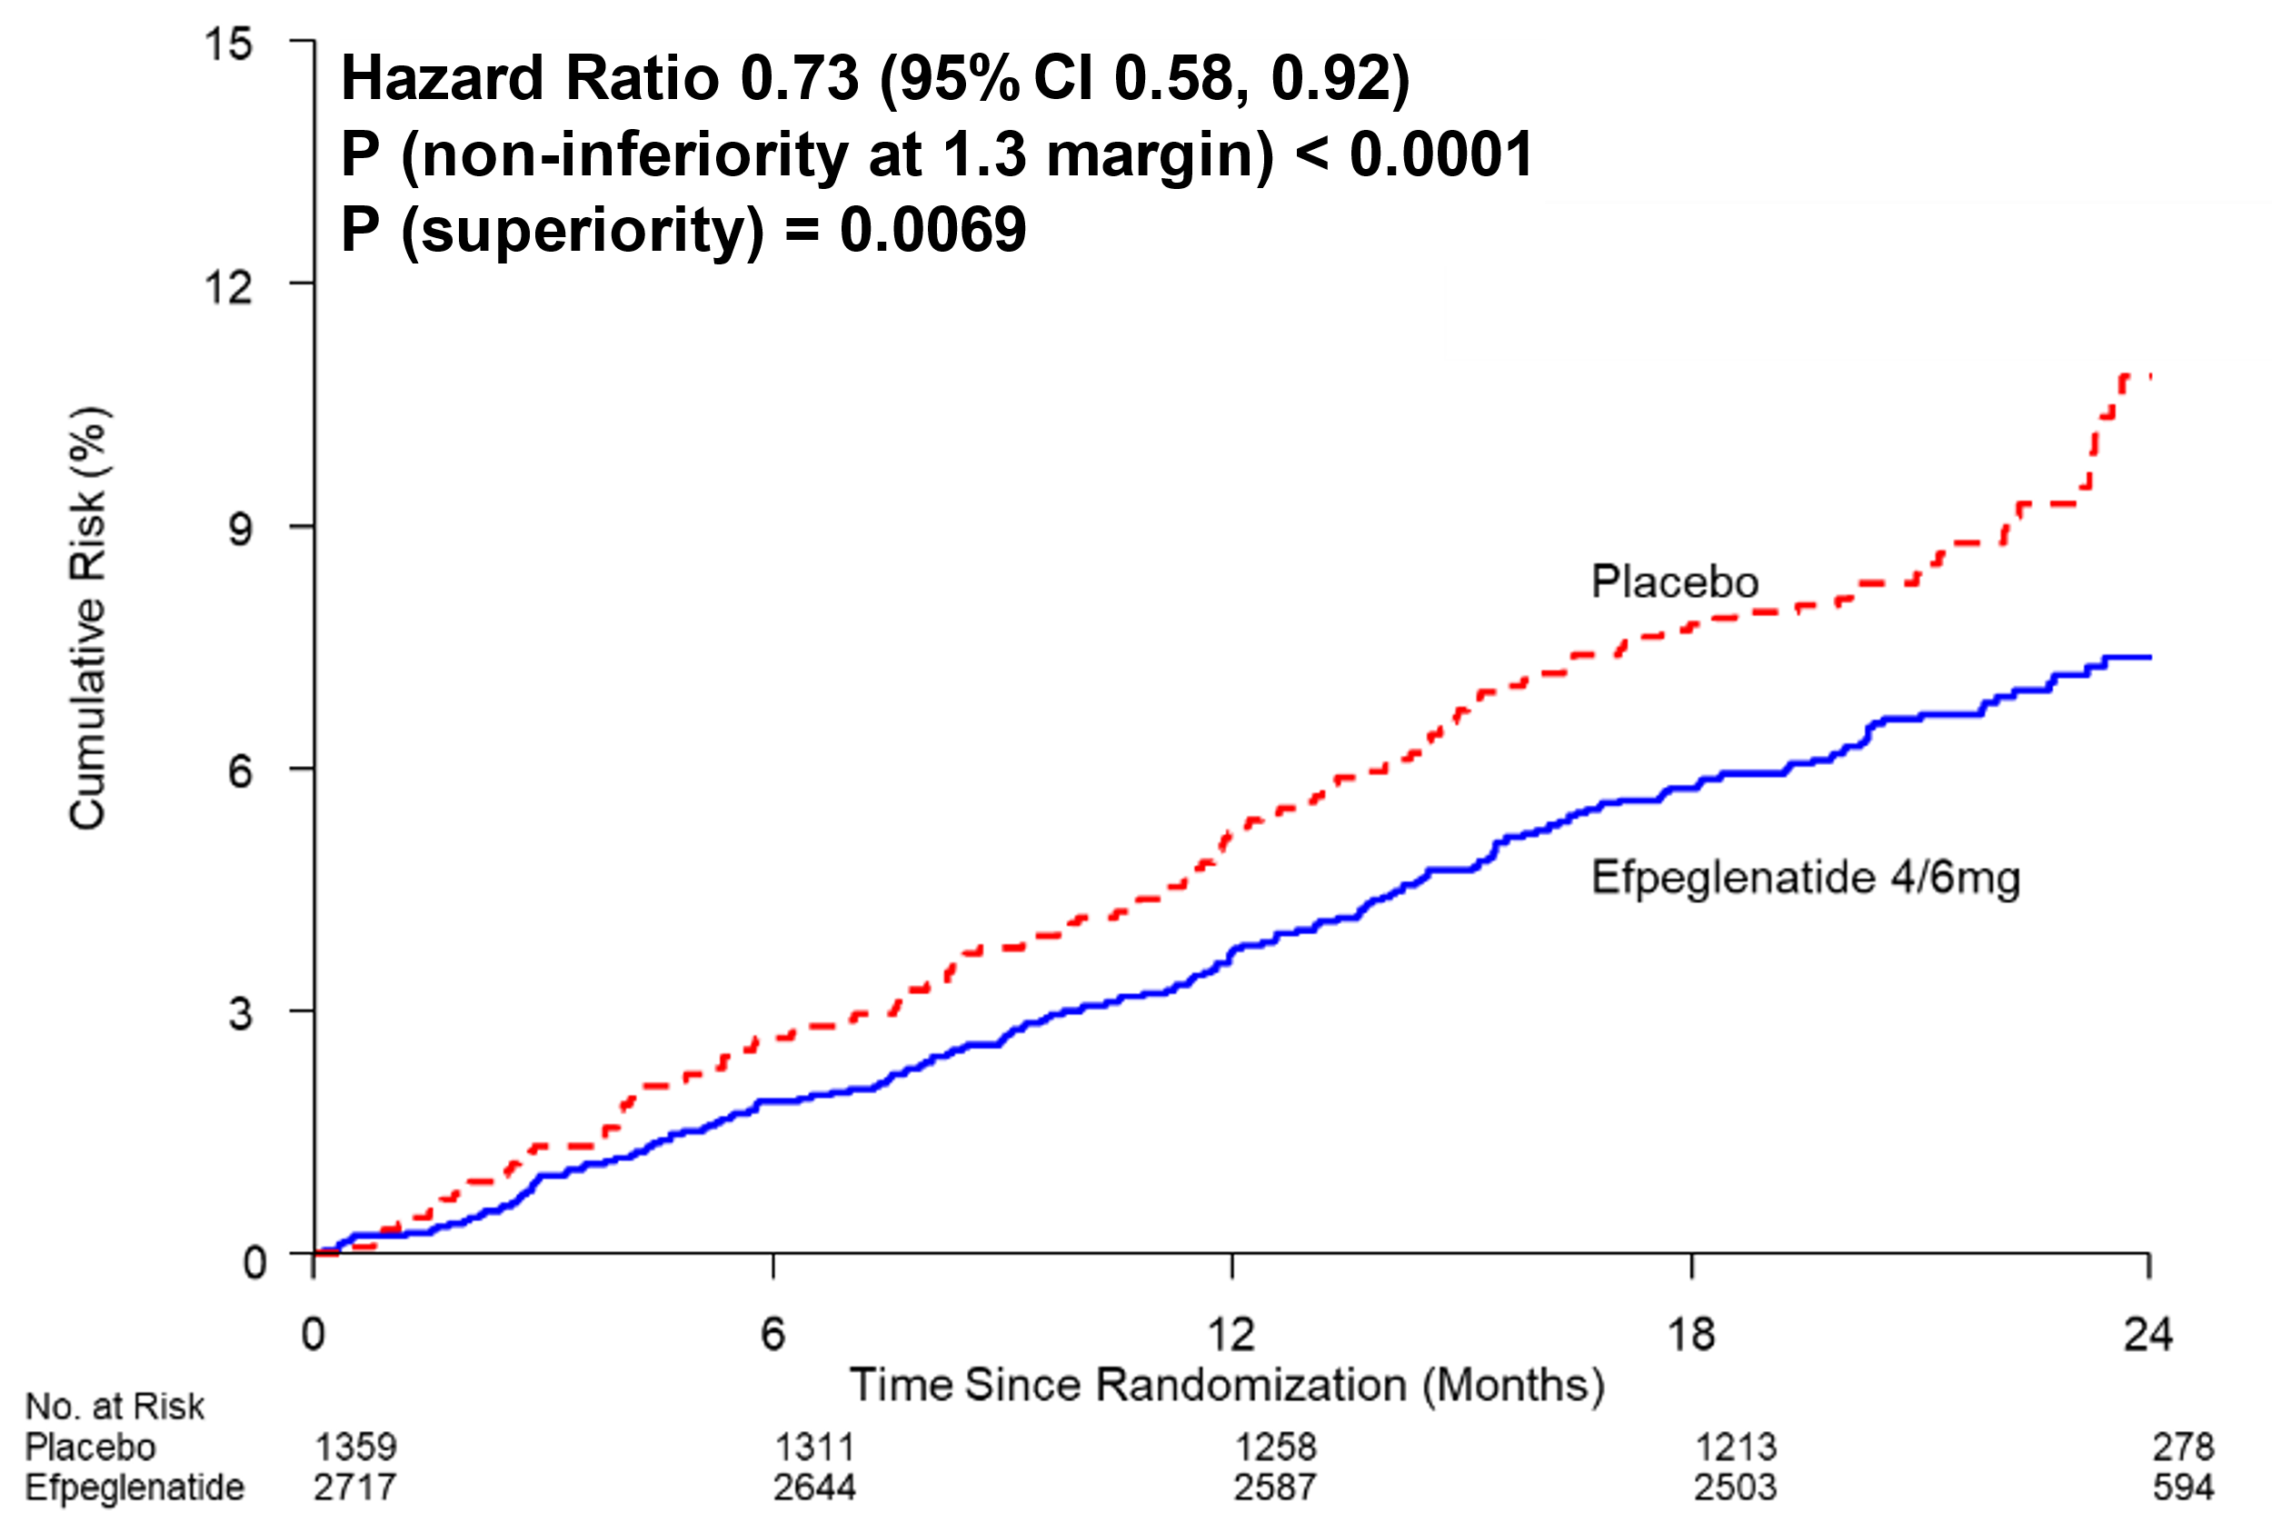
Efpeglenatide 4 or 6 mg versus Placebo
MACE

Slide 39
Design Features
Assuming placebo MACE rate >3.7% & 12-month recruitment, N~4000 provided 90% power for non-inferiority at 1.3 margin
Study Duration: until 330 MACE events
If non-inferiority for the primary outcome, additional outcomes were hierarchically assessed for superiority until non-significant:
  MACE
  MACE or coronary revascularization or unstable angina hospitalization
  New or worsening nephropathy (i.e., renal composite)
  MACE or non-CV death
  Renal function outcome (i.e., outcome 3 [without albuminuria criterion] or death)
  MACE, non-CV death, heart failure, or renal function outcome

Slide 40
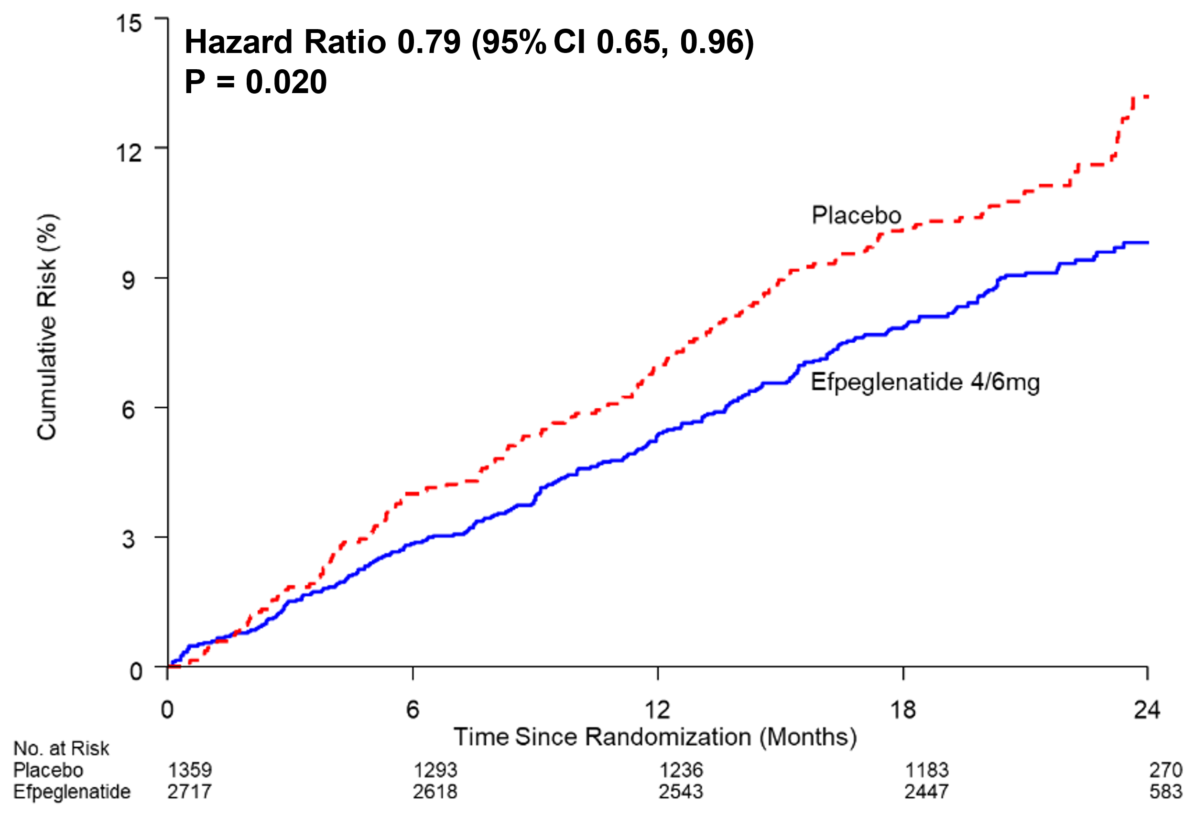
Efpeglenatide 4 or 6 mg versus Placebo
MACE, Coronary Revascularization, or Unstable Angina

Slide 41
Efpeglenatide 4 or 6 mg versus Placebo
Kidney Composite Outcome
Outcome Definition = 1 or more of:
New macroalbuminuria (ACR > 300 mg/g) and ≥ 30% rise from baseline
Decrease in eGFR by ≥ 40% from baseline for ≥ 30 days
Kidney replacement therapy for ≥ 90 days
eGFR < 15 ml/min/1.73 m² for ≥ 30 days

Slide 42
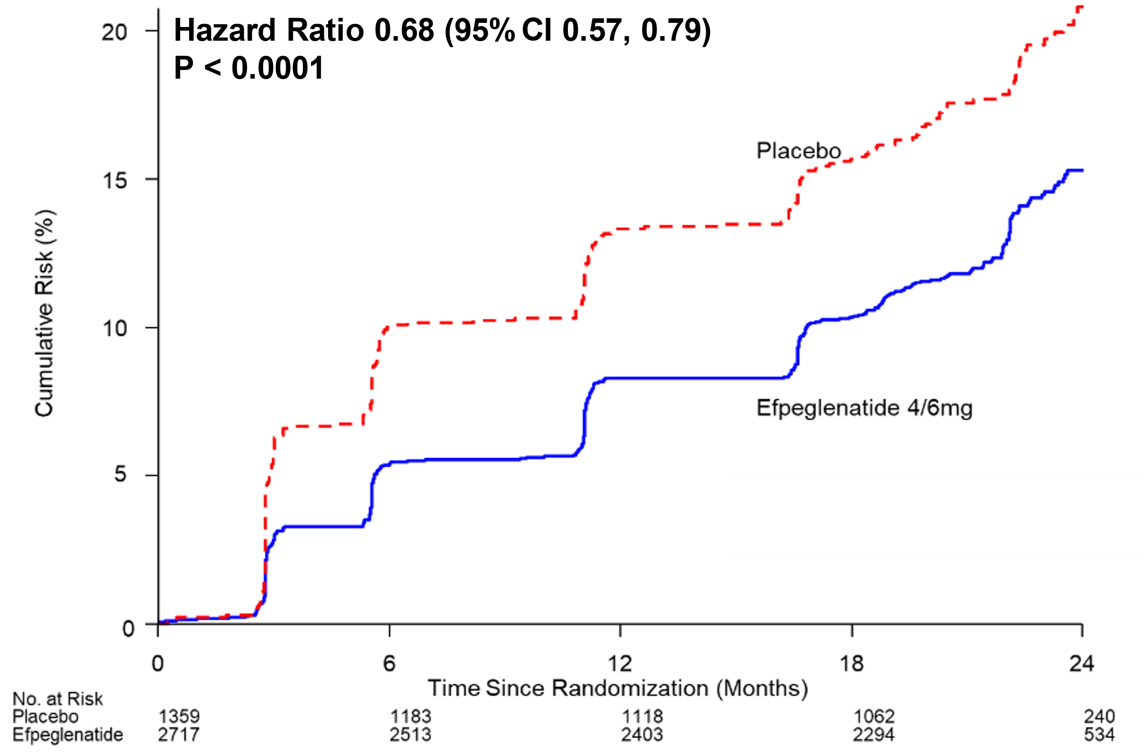
Efpeglenatide 4 or 6 mg versus Placebo
Kidney Composite Outcome*
*New MA, eGFR fall ≥ 40%, kidney replacement therapy, or eGFR < 15

Slide 43
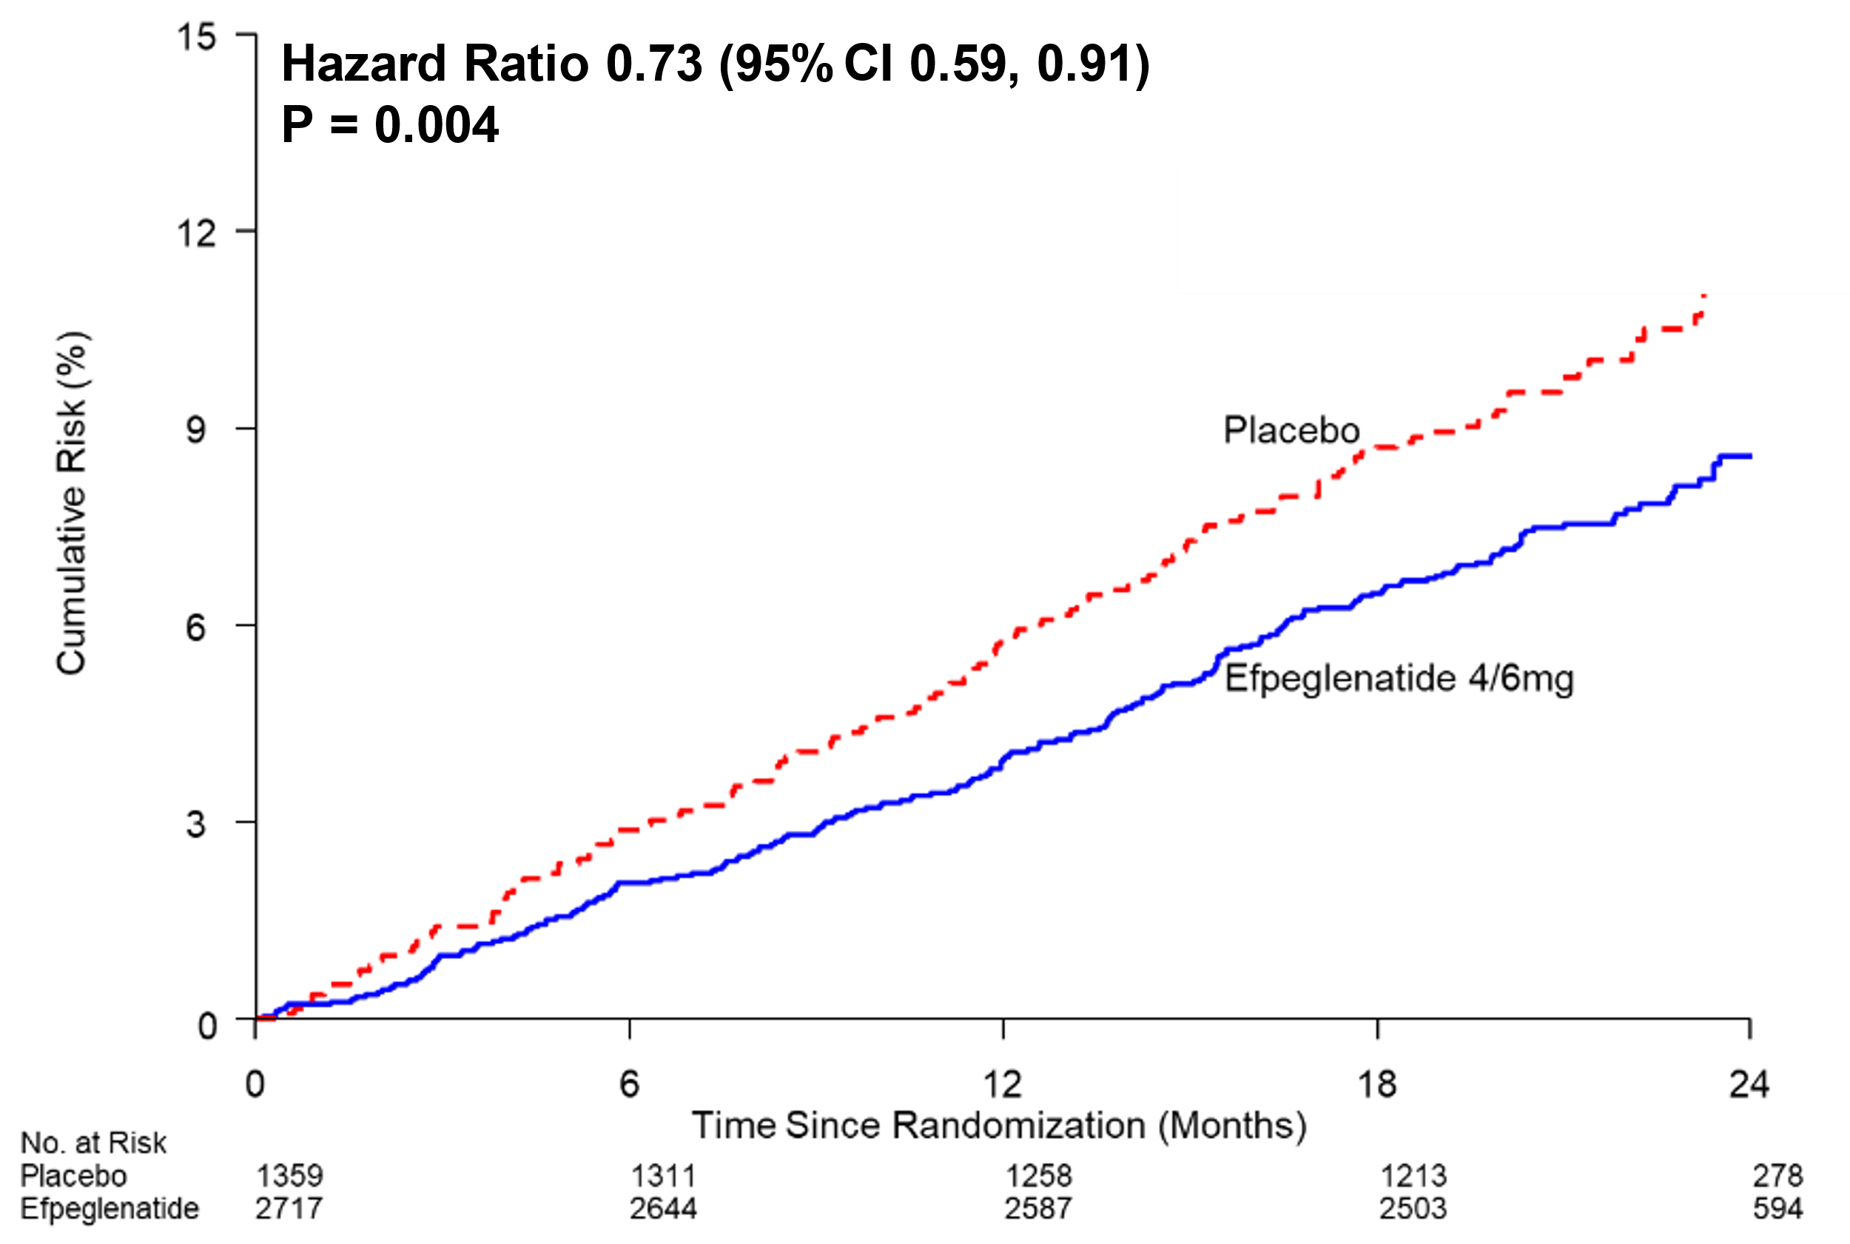
Efpeglenatide 4 or 6 mg versus Placebo
MACE or non-Cardiovascular Death

Slide 44
Primary and Secondary Outcomes
 | Efpeglenatide N/100 py | Placebo N/100 py | HR (95%CI) | P
Primary Outcome (MACE) | 3.9 | 5.3 | 0.73 (0.58, 0.92) | 0.0069
Expanded MACE | 5.4 | 6.8 | 0.79 (0.65, 0.96) | 0.020
Renal Composite Outcome | 7.7 | 11.6 | 0.68 (0.57, 0.79) | <0.0001
MACE or non-CV Death | 4.5 | 6.0 | 0.73 (0.59, 0.91) | 0.0040
Renal Function (no MA) or Death | 2.5 | 3.1 | 0.77 (0.57, 1.02) | 0.072
MACE, non-CV Death, HF, Renal Function (no MA) | 5.1 | 7.0 | 0.71 (0.59, 0.87)

Slide 45
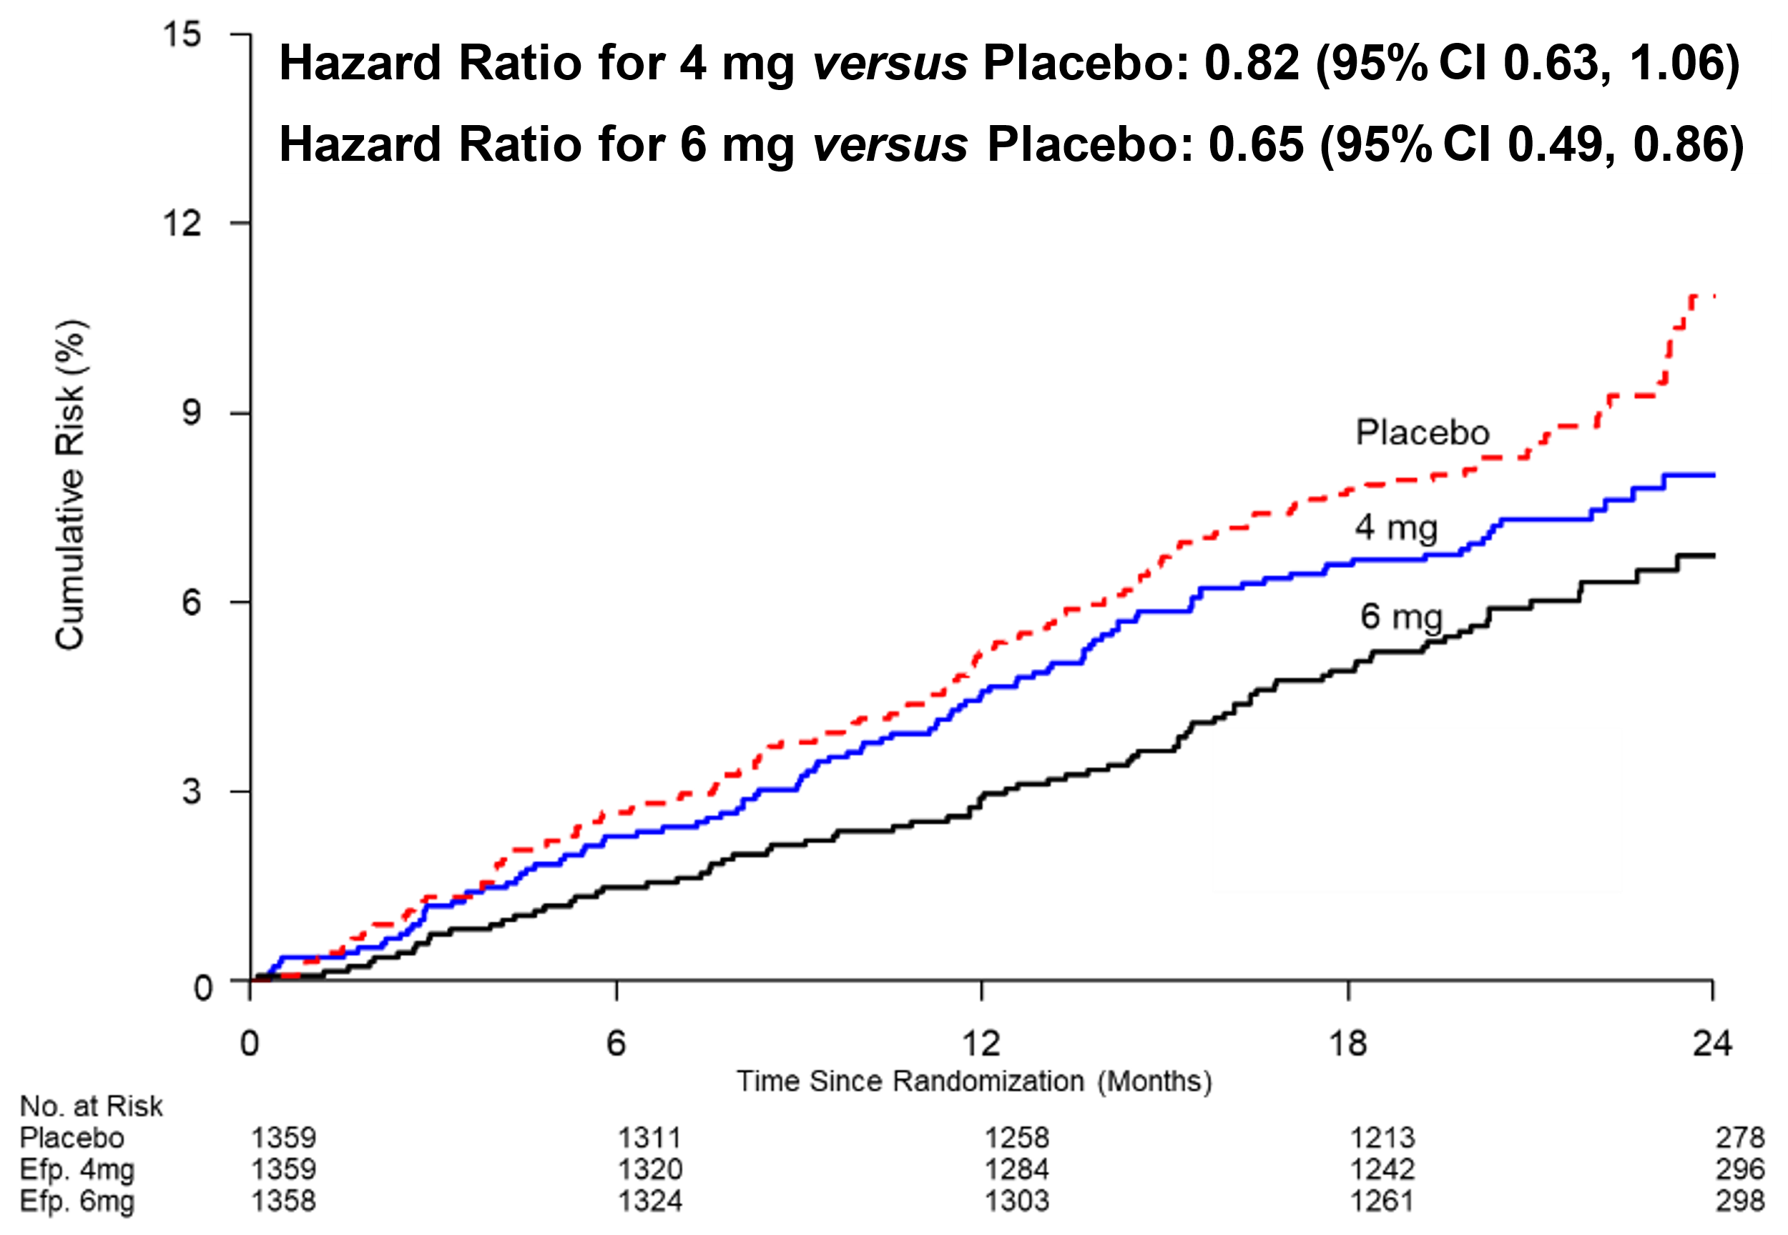
Efpeglenatide 4 and 6 mg versus Placebo
MACE - Exploratory

Slide 46
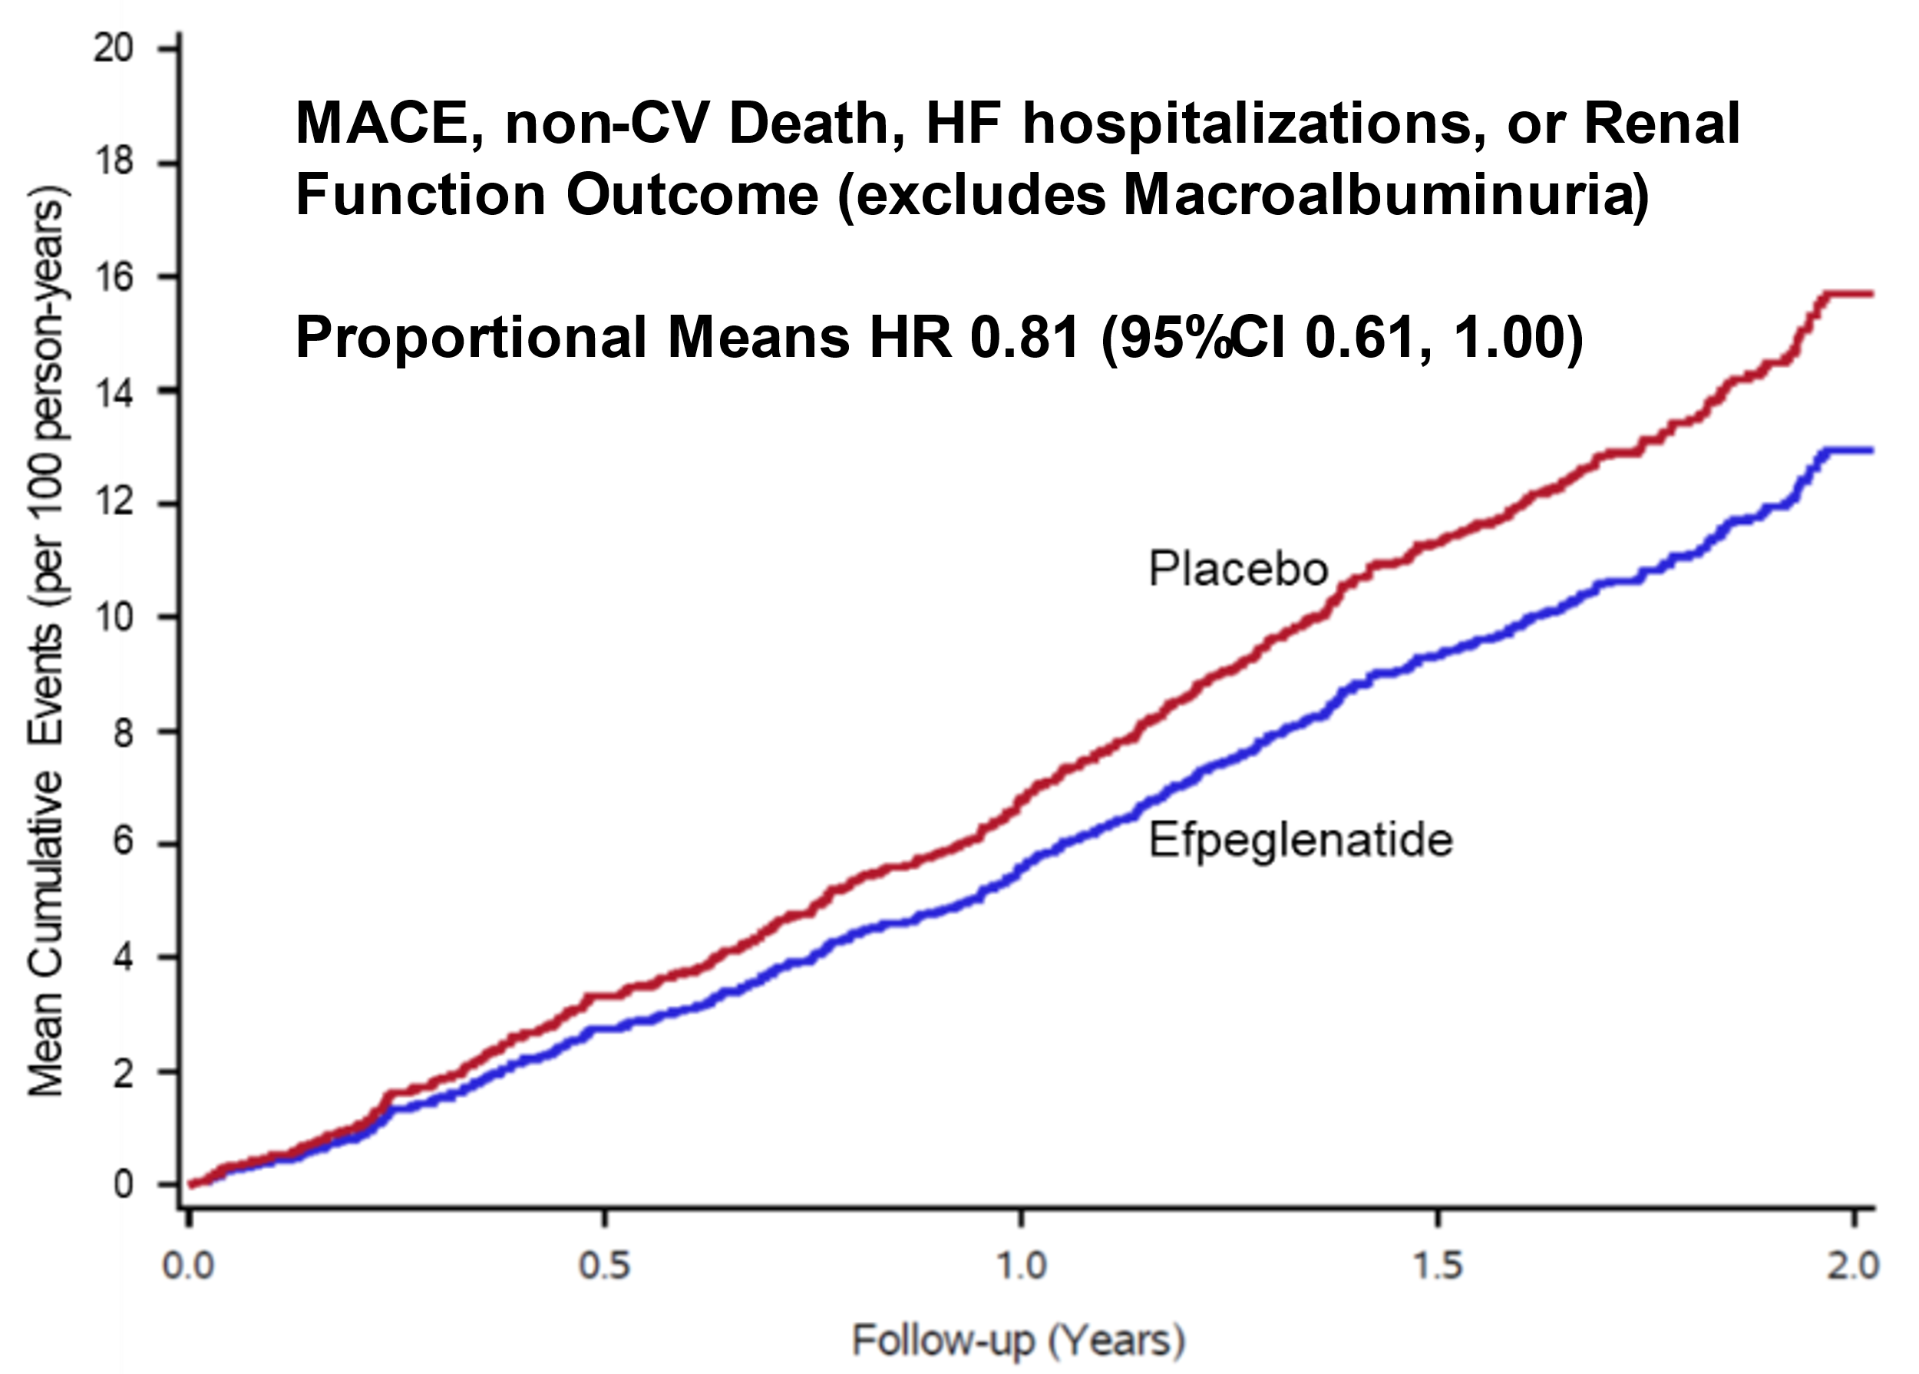
Efpeglenatide 4 or 6 mg versus Placebo
Effect on Total Cardiorenal Events (Including Recurrent) - Exploratory

Slide 47
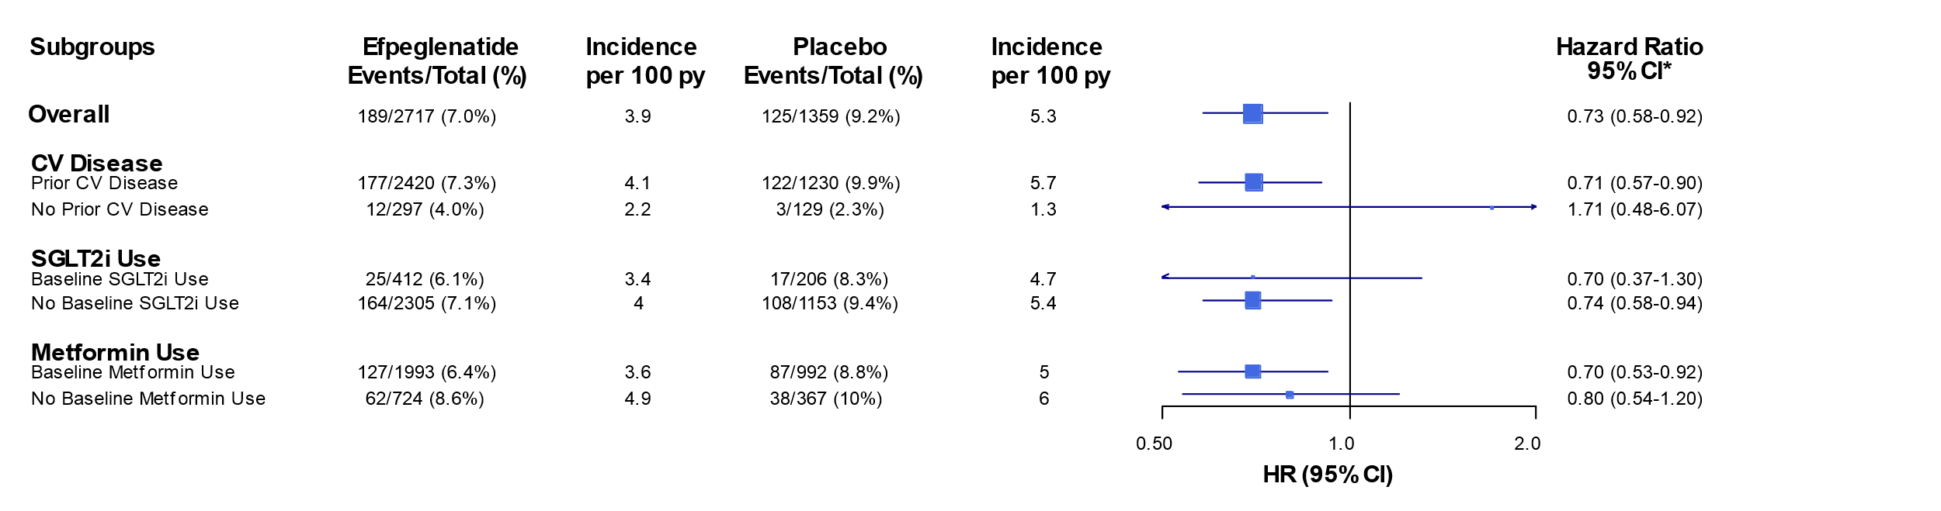
Effect on MACE Within Pre-specified Subgroups
Baseline SGLT2i Use in = 618 (15.2%)

Slide 48
Summary of AMPLITUDE O’s Results
In people with type 2 DM & a high prevalence of CV & kidney disease with a high HbA1c & moderate use of an SGLT2i…
… efpeglenatide (4 or 6 mg) sc/week significantly & safely reduced
    MACE (including death from unknown causes) by 27%
    MACE, coronary revascularization or UA by 21%
    A renal composite outcome by 32%
    MACE or non-CV death by 27%
These effects were independent of baseline SGLT2i, eGFR or metformin use

Slide 49
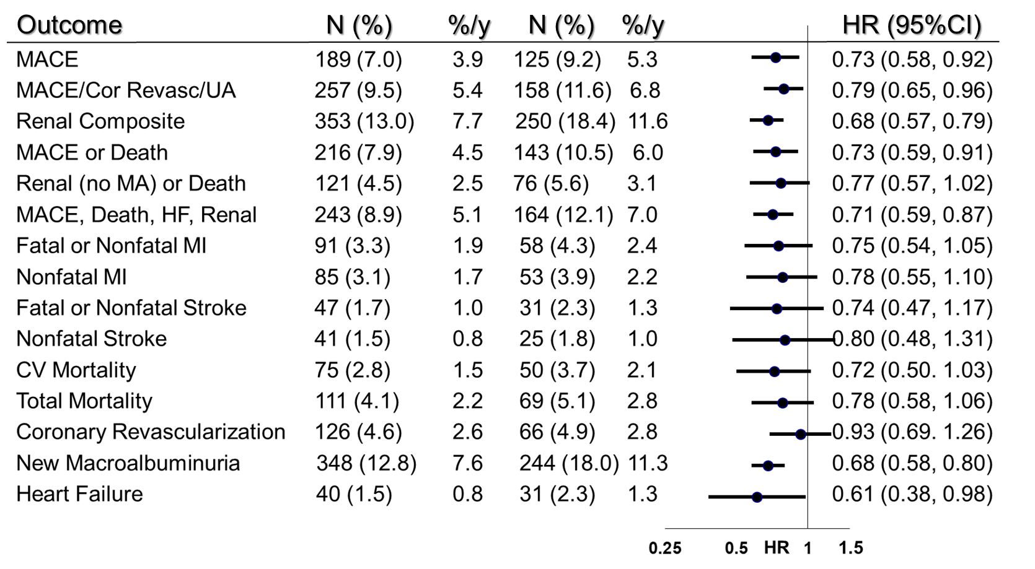
Summary of CV/Kidney Effects of Efpeglenatide
Significant
Exploratory

Slide 50
Summary of CV/Kidney Effects of Efpeglenatide
Primary
Significant
Secondary
Exploratory

Slide 51
Number-Needed-to-Treat (1.8 Years)
For the Significantly Reduced Outcomes
Outcome | Efpeglenatide N Events (%) | Placebo N Events (%) | NNT (1.8 years)
Primary Outcome (MACE) | 189 (7.0) | 125 (9.2) | 46
MACE, Coronary Revascularization, Unstable Angina Hospitalization | 257 (9.5) | 158 (11.6) | 48
MACE or non-CV Death | 216 (7.9) | 143 (10.5) | 39
Renal Composite Outcome | 353 (13.0) | 250 (18.4) | 19

Slide 52
Overall Conclusion
The AMPLITUDE O trial shows that the exendin-4 based GLP-1 RA drug efpeglenatide…
… safely reduces major cardiovascular and renal outcomes in high-risk people with type 2 diabetes while lowering glucose, blood pressure and weight

Slide 53
